Slide 1
Java Selenium Batch-4
Capstone Project
on
Amazon Automation e - Commerce
Name – Apurv Kumar
Superset ID - 3305010

Slide 2
Contents :
Project Overview And Structure
Feature Files
Runner Class
Page Object Model
Step Definitions
Page Object Model
POM.xml
Utils Class
Report Class &
Extent Reports
Testng Reports
Console Output
Screenshots
Git

Slide 3
Project Overview
The Amazon Capstone Project is an automation testing framework designed for validating the Amazon e-commerce purchase flow. It is built using Selenium Web Driver with Java, following the Page Object Model (POM) design for reusability and maintainability. The framework uses Cucumber BDD to define business-readable scenarios in feature files, with runner classes and step definitions connecting them to Selenium code. The project structure includes page classes for Amazon modules such as Login, Home, Cart, Checkout, and Results, along with utilities for Web driver setup, waits, screenshots, and reusable methods. The framework includes feature files, runner classes, step definitions, page objects, utilities, and reporting .

Slide 4
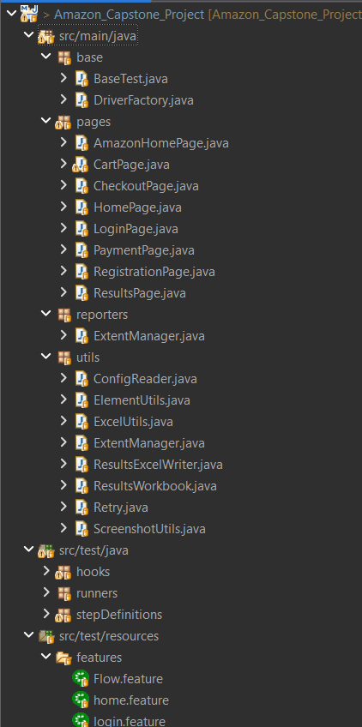
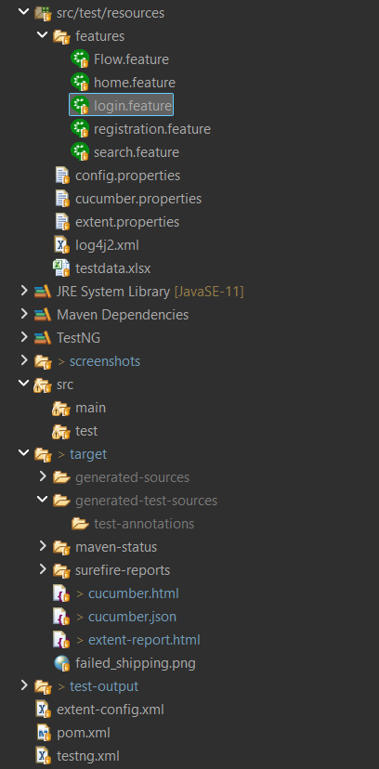
Project Structure

Slide 5
Feature File
1. Flow. Feature
Represents an end to end (like complete purchase process).
Combines multiple steps: login → search → add to cart → checkout.
2. Home. Feature
Covers scenarios related to Amazon homepage.
Example: validating page title, navigating through menus, checking banners.
3. login. Feature
Defines login functionality scenarios.
Example: login with valid credentials, invalid credentials, blank fields.

Slide 6
3. login. Feature
Defines login functionality scenarios.
Example: login with valid credentials, invalid credentials, blank fields.
4.Registration.feature
Contains scenarios for new user sign-up.
Example: filling registration form, verifying OTP/email, successful account creation.
5. Search. Feature
Includes scenarios for searching products.
Example: searching by product name, applying filters, validating results.

Slide 7
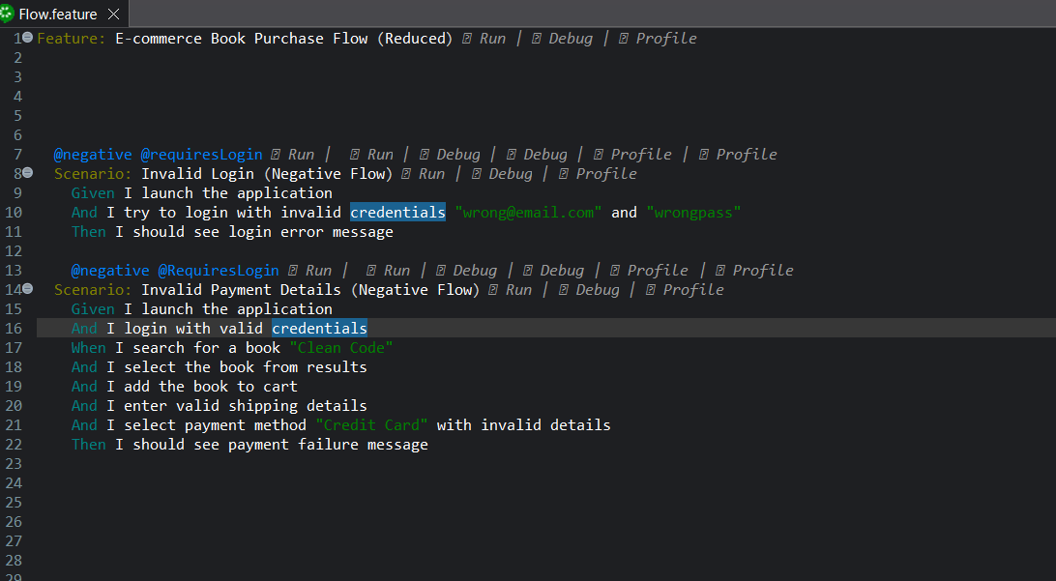
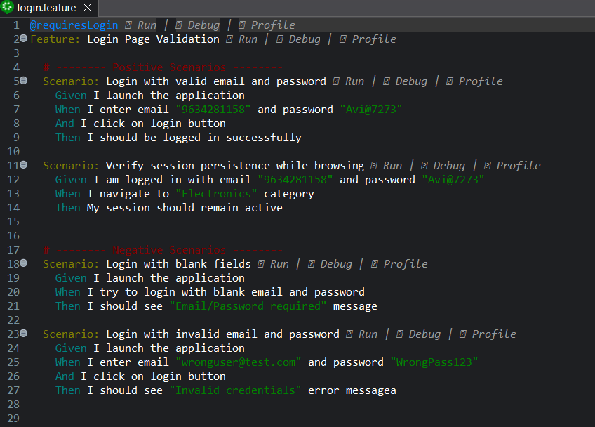

Slide 8
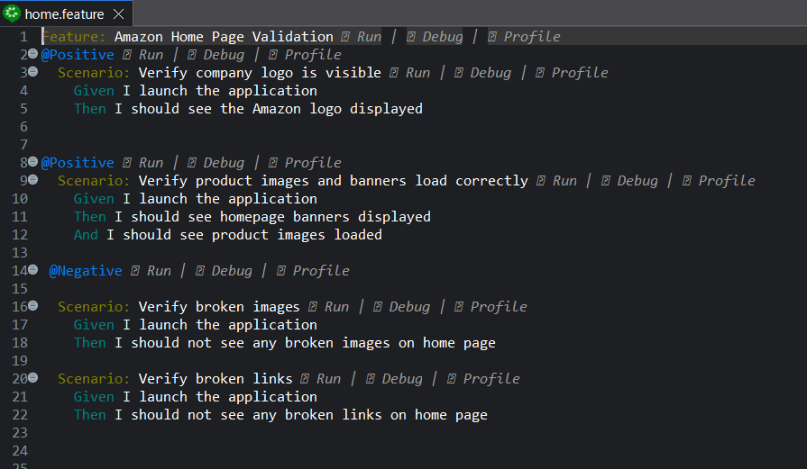
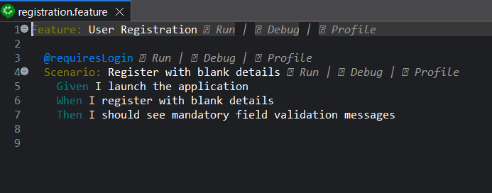
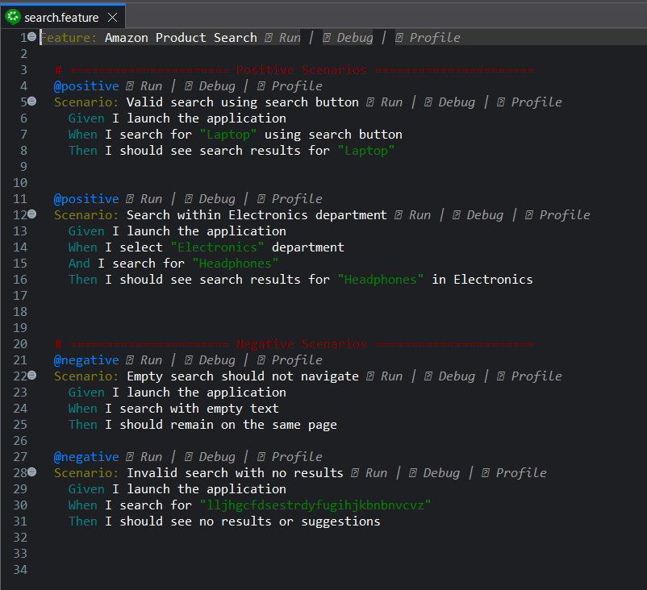

Slide 9
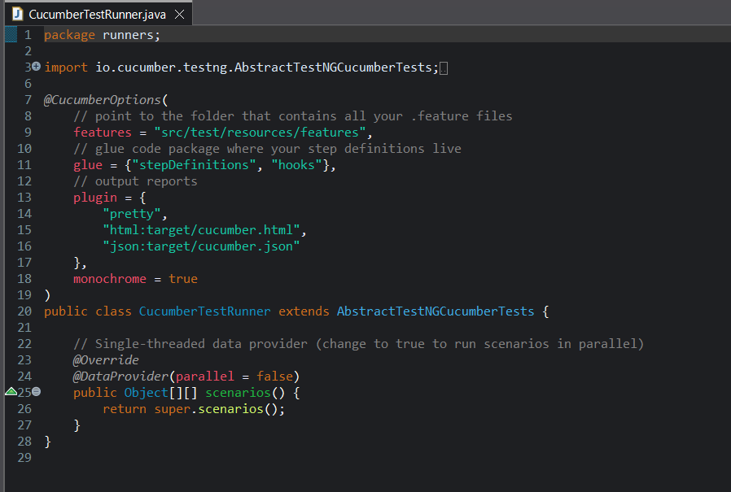
Runner Class
In a Cucumber BDD framework, the Runner Class is responsible for:
Executing the feature files.
Linking feature files → step definitions.
Generating reports (TestNG, Extent, etc.).
It uses important annotations like:
Test Runner .java
The Test Runner.java class integrates Cucumber with TestNG to execute all feature files in the project.
It specifies feature file locations, step definitions, and generates HTML and JSON reports for automation results

Slide 10
Step Definitions
In a Cucumber BDD framework, a Step Definition is the glue code that connects the steps written in a feature file.
1. Headphone Purchase Steps.java
Implements steps for the end-to-end book purchase flow.
Covers login → search → add to cart → checkout → payment → confirmation.
2. CommonSteps.java
Contains reusable step definitions used across multiple features.
Example: launching browser, navigating to URL, closing browser.
3.HomeSteps.java
Implements steps for the Amazon homepage.
Covers homepage validations (title, logo, navigation menus, banners).
4. LoginSteps.java
Implements steps from login. Feature.
Handles login actions (entering credentials, clicking login, verifying result).
5. RegistrationSteps.java
Implements steps from registration. Feature.
Automates new user signup (form filling, OTP verification, successful account creation).
6. SearchSteps.java
Implements steps from search. Feature.
Automates searching for products, applying filters, and validating search results.

Slide 11
Page Object Model (POM)
A design pattern where each web page is a separate class, containing its UI element locators and the methods to interact with them. This makes the code cleaner and easier to maintain.
AmazonHomePage.java : This class represents the main landing page of Amazon, including locators and methods to interact with search bars, banners, and navigation links.
CartPage.java : This class contains elements and methods for verifying items in the shopping cart and managing cart-related actions like updating or removing products.

Slide 12
CheckoutPage.java This class defines locators and interactions on the checkout page, such as reviewing order details and proceeding with payment.
HomePage.java This class represents the homepage structure with UI elements like product images, banners, and navigation components used for validation.
LoginPage.java This class encapsulates the elements and actions on the login page, such as entering credentials and handling authentication workflows.

Slide 13
PaymentPage.java This class includes locators and methods for managing payment options and validating payment-related inputs during the checkout process.
RegistrationPage.java This class holds the UI elements and methods related to the registration form, including field validations and form submission steps.
ResultsPage.java This class manages the search results page, providing methods to interact with product listings and validate that the correct search results are displayed.

Slide 14
Pom.xml
POM stands for Project Object Model.
The pom.xml is an XML file that contains information about the project and configuration details used by Maven to build the project.
Contains locators and reusable methods for interacting with page elements.
Keeps feature files and step definitions clean by moving UI logic into page classes. Makes the framework modular, maintainable, and scalable for future enhancements.

Slide 15
6. ResultsWorkbook.java
Manages the Excel workbook object.
Provides methods to handle Excel sheets, rows, and cells.
7. Retry.java
Implements retry logic for failed tests.
Allows tests to automatically retry a certain number of times before final failure.
8. ScreenshotUtils.java
Captures screenshots during test execution.
Useful for debugging or attaching to reports when a test fails.

Slide 16
Util Class
1. ConfigReader.java
Reads configuration properties (like URLs, browser type) from a .properties file.
Provides methods to get config values.
2. ElementUtils.java
Contains reusable methods to interact with web elements (click, send keys, get text).
Helps avoid code duplication in tests.
3. ExcelUtils.java
Handles reading data from Excel files.
Useful for data-driven testing.
4. ExtentManager.java
Manages Extent reports setup for test reporting.
Helps initialize and configure the report file.
5. ResultsExcelWriter.java
Writes test results (pass/fail) back to an Excel file.
Supports result tracking.

Slide 17
Report Class
Extent Report
Manages the creation and configuration of Extent reports for test execution.
Creates time stamped HTML reports to ensure each test run has a unique report file.
Provides methods to create and retrieve individual test logs and flush reports to disk after execution.
Test execution status (Pass, Fail, Skip) with color codes.
Step-wise logging and exception details.

Slide 18
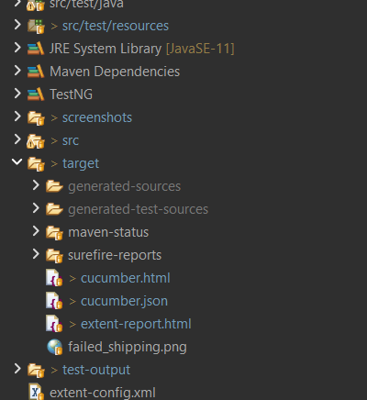
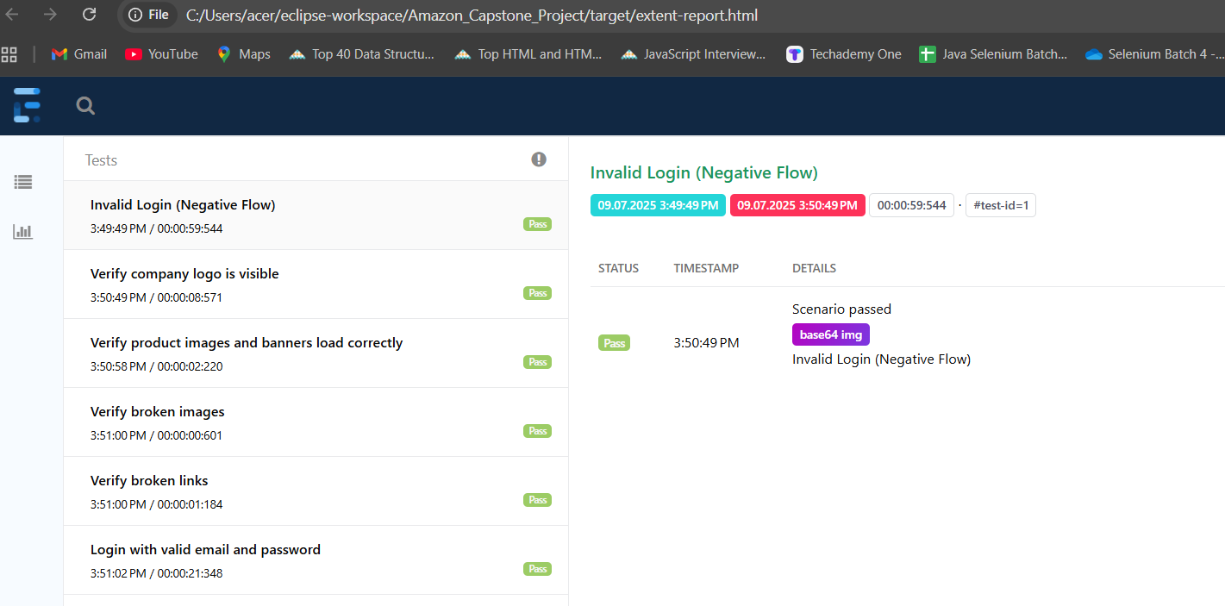
Extent Report . html

Slide 19
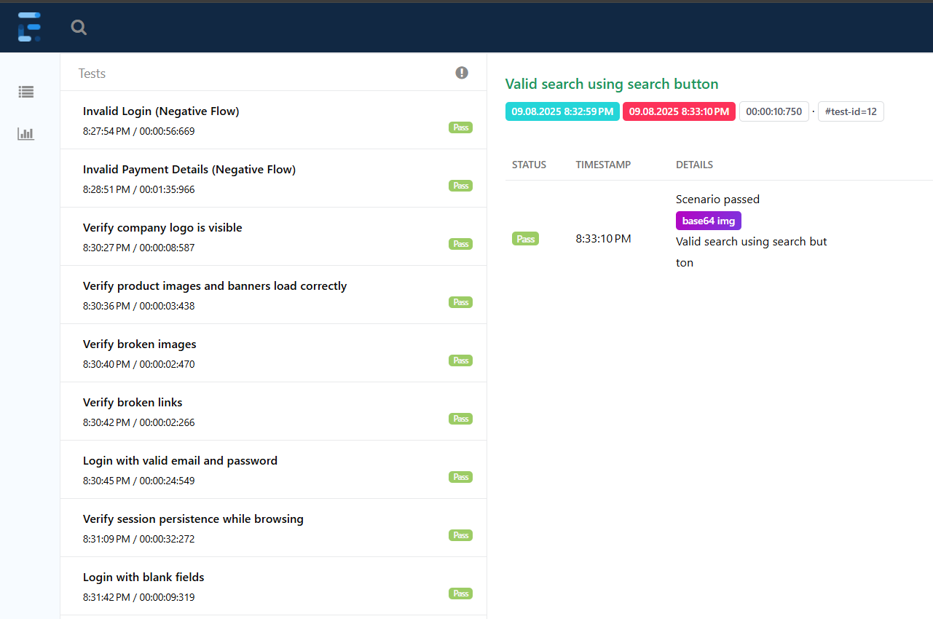
Extent Report.html -2

Slide 20
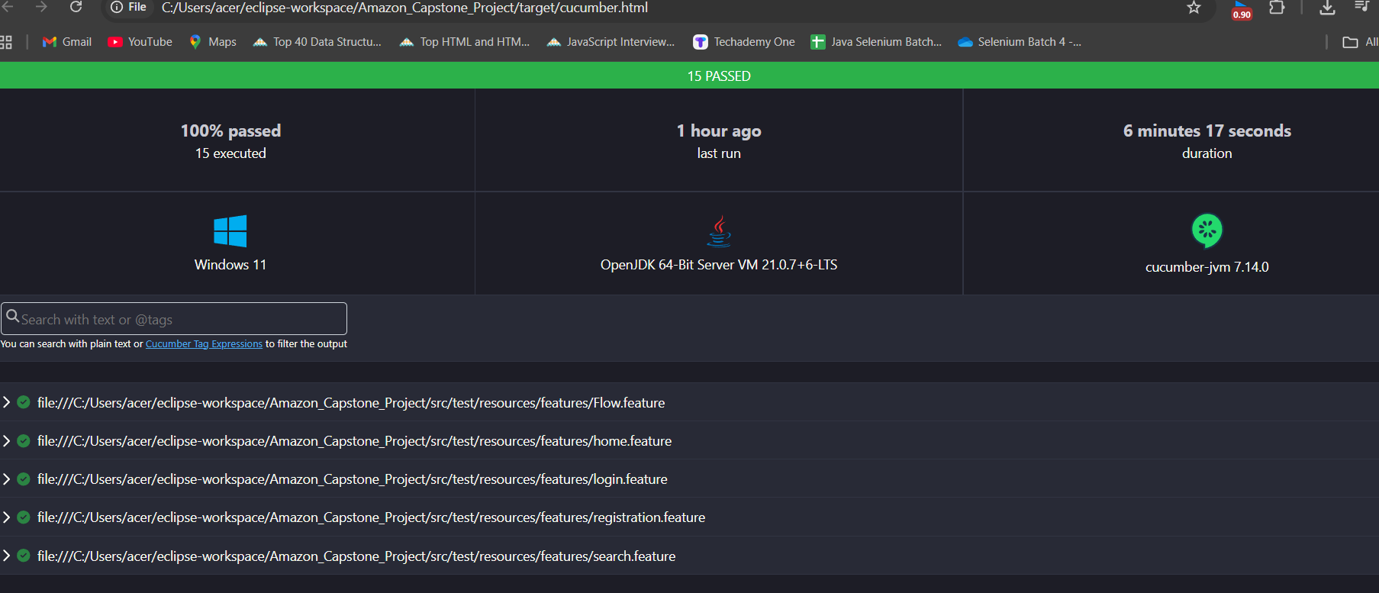
Cucumber Report

Slide 21
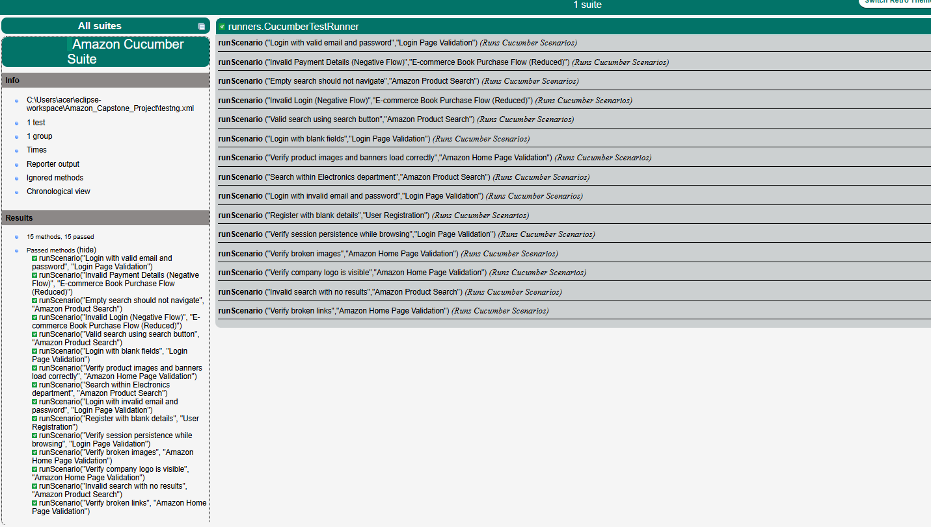
Index.html

Slide 22
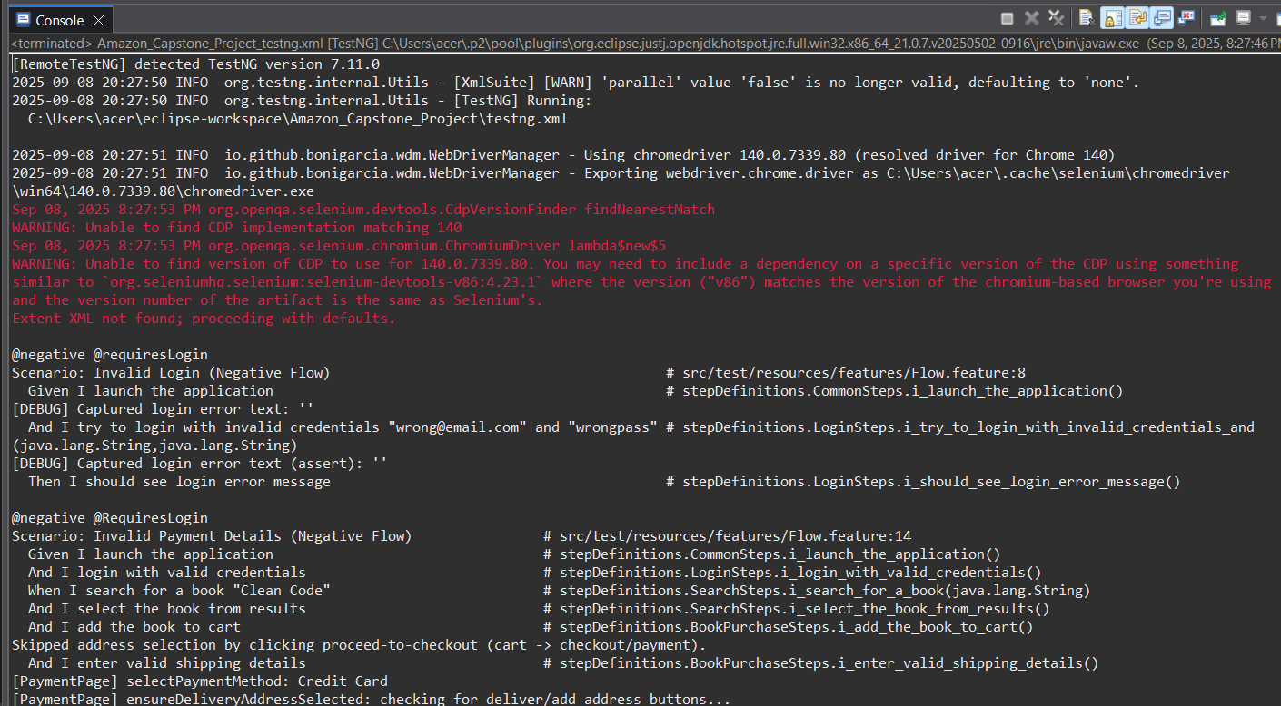
Console Outputs

Slide 23
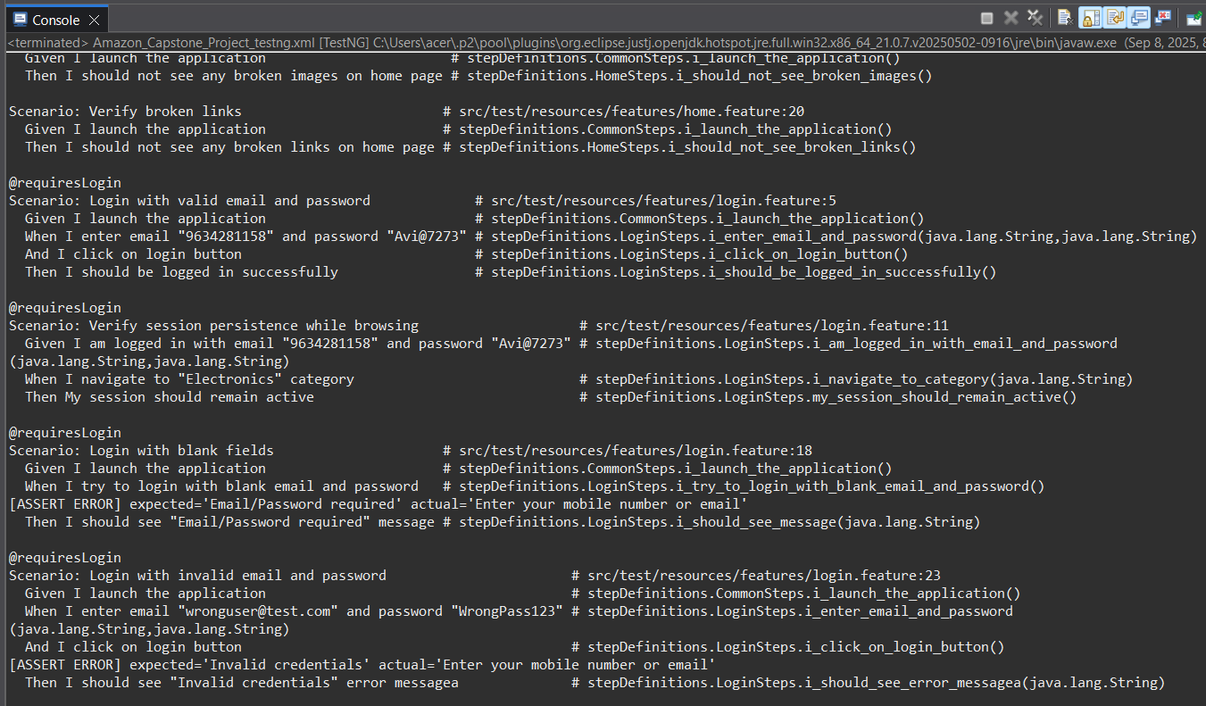

Slide 24
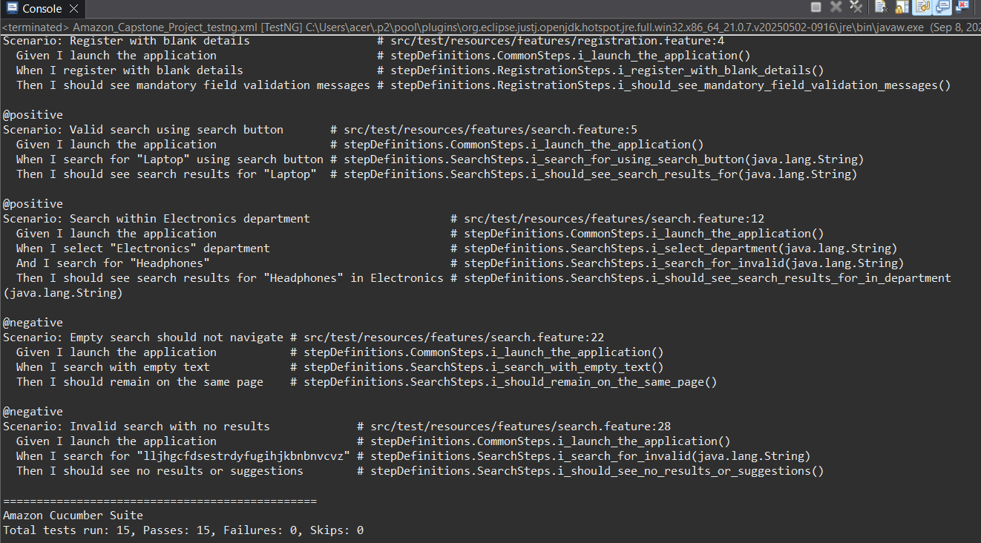

Slide 25
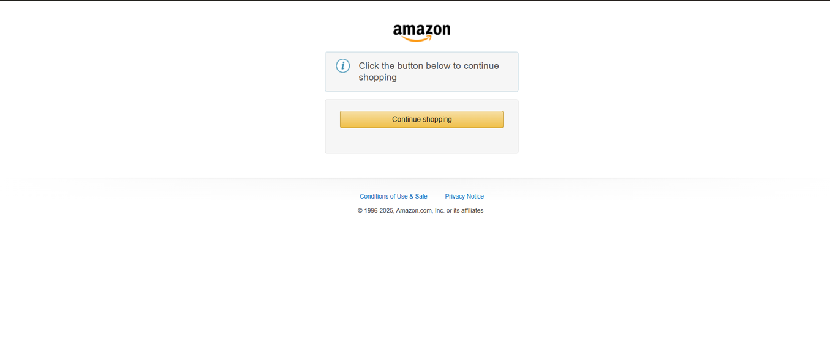
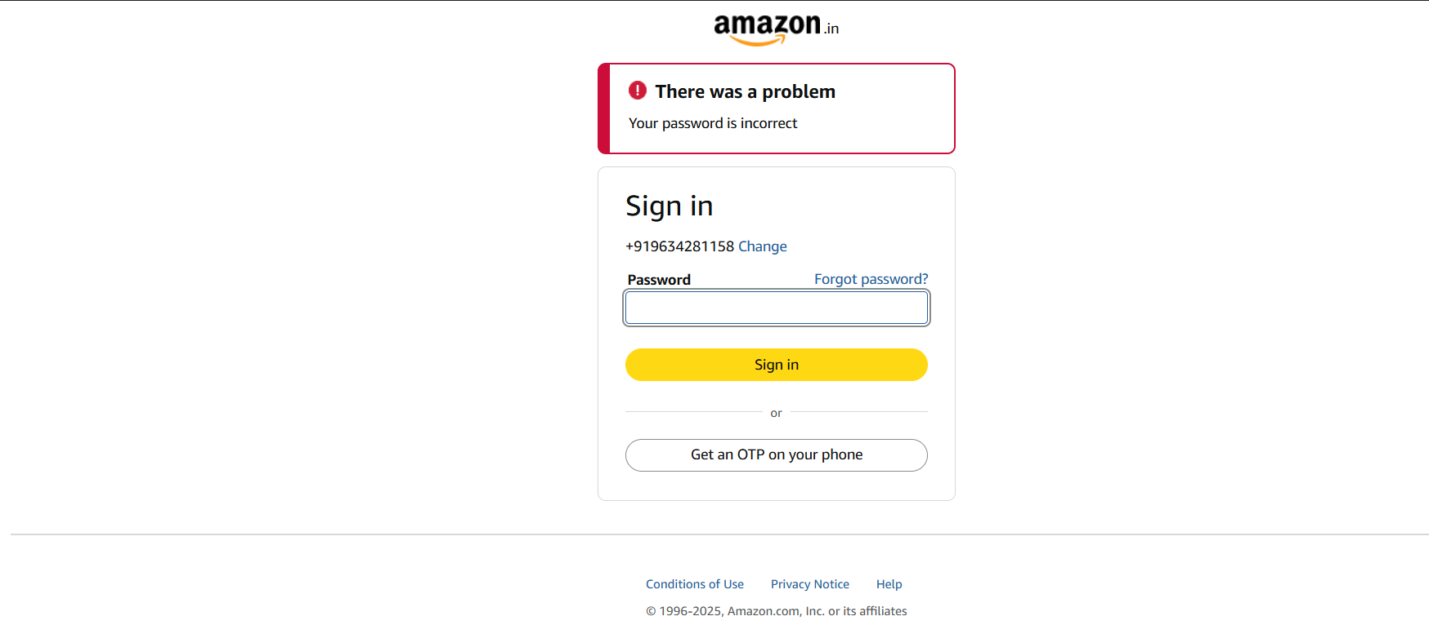
Screenshots

Slide 26
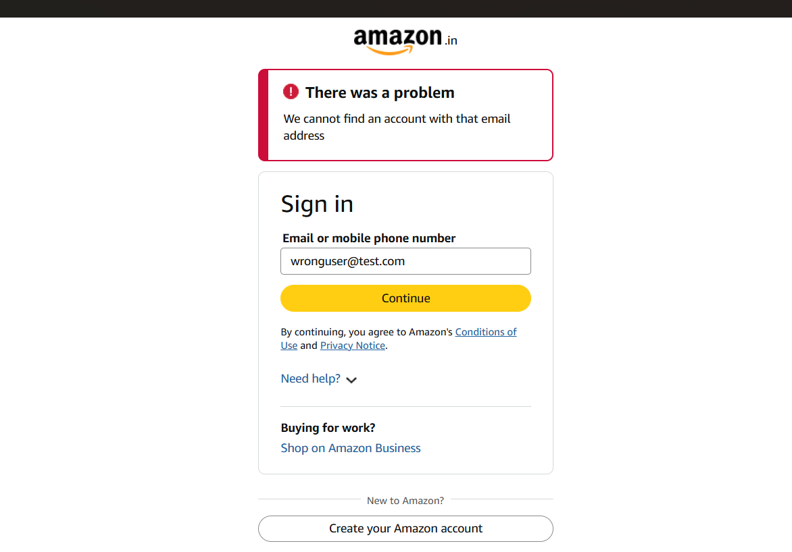
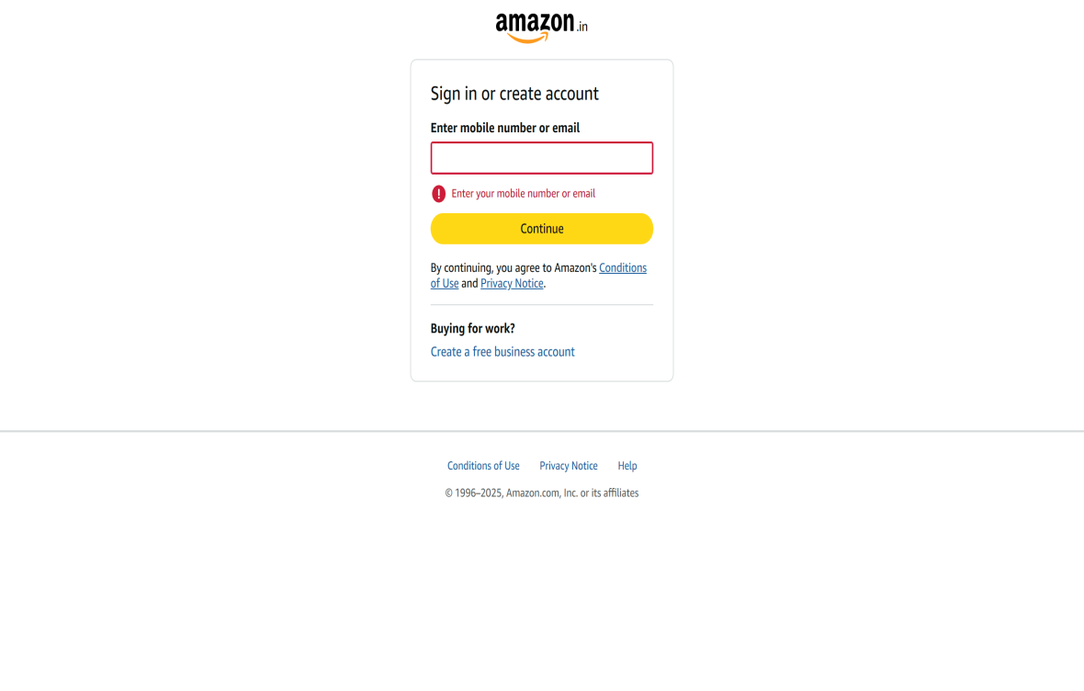

Slide 27
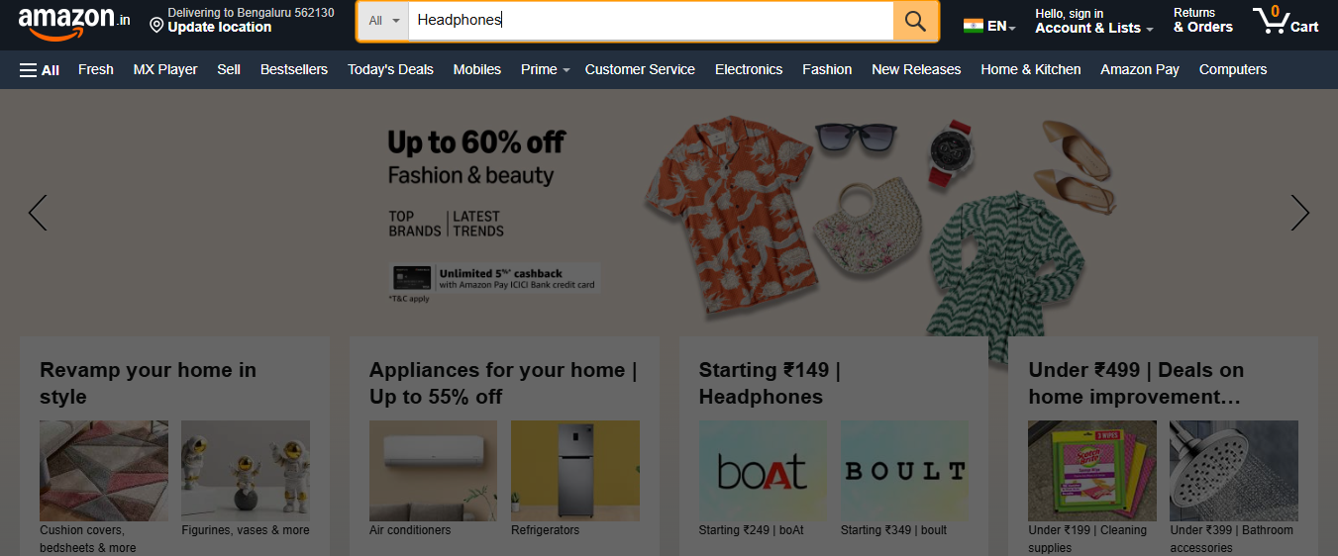

Slide 28
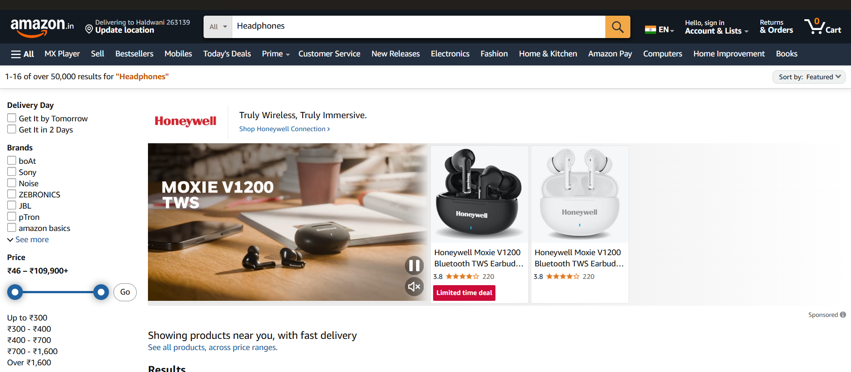

Slide 29
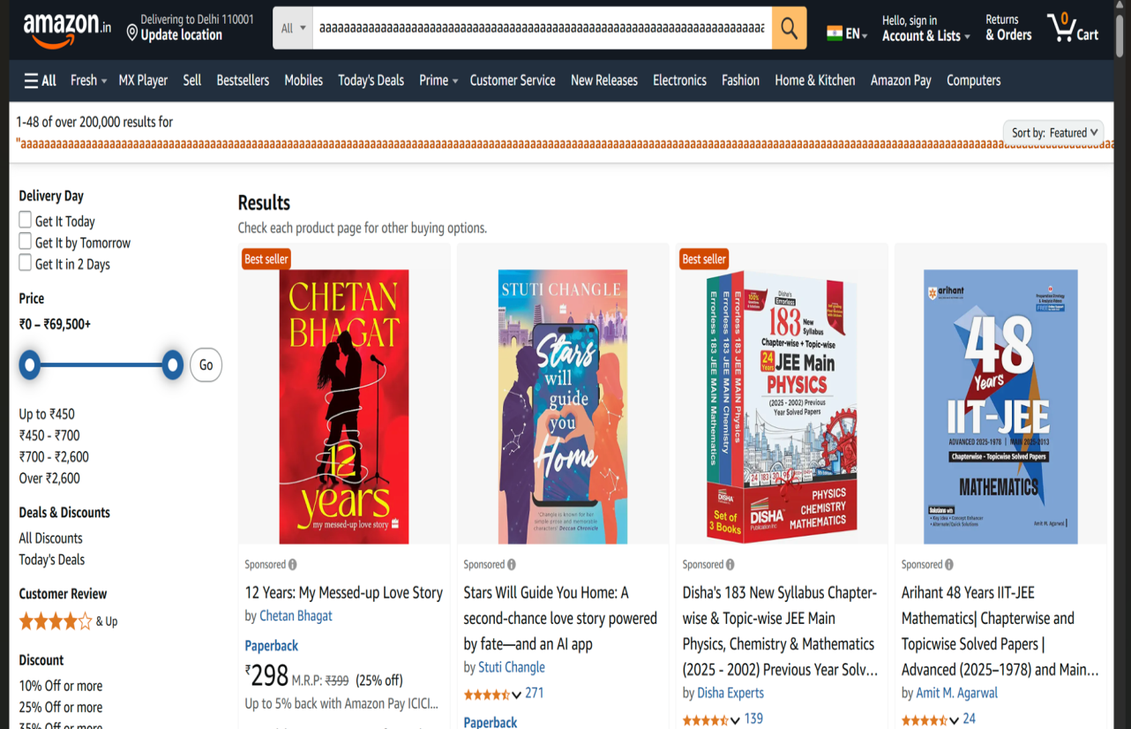

Slide 30
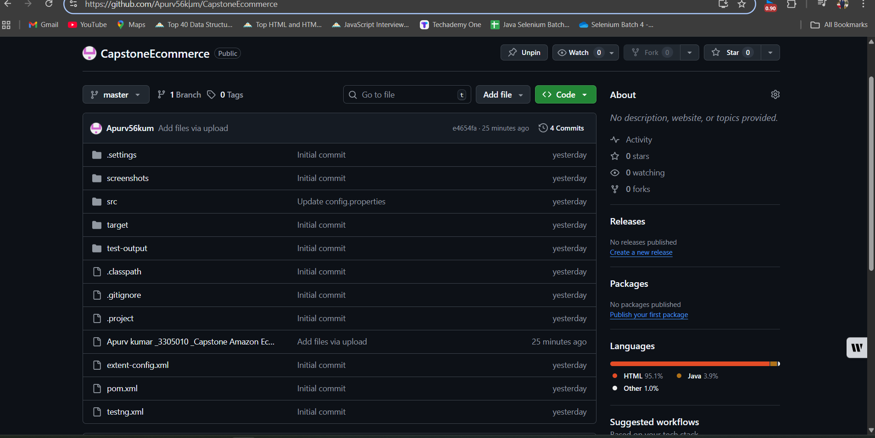
GIT - Project Repository & Version Control
Github Repository link - https://github.com/Apurv56kum/CapstoneEcommerce

Slide 31
THANK YOU

